Slide 1


Ocean-Atmosphere Interactions in the Indian Ocean
Alex Hewett
University of Washington (Undergraduate - Atmospheric Sciences)
NOAA Pacific Marine Environmental Laboratory (PMEL)
Mentor: Dr. Mike McPhaden

Slide 2
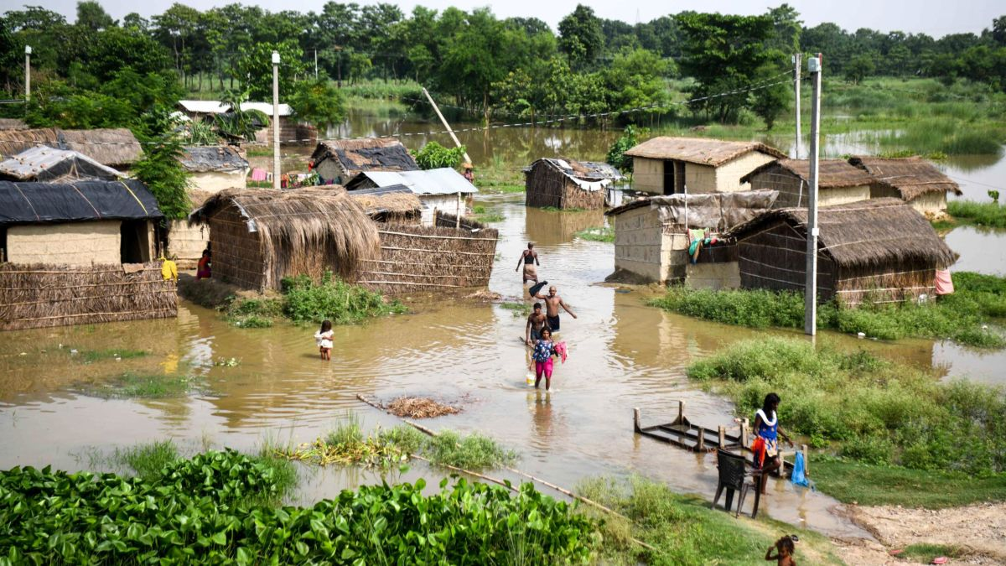
Why study the Indian Ocean and monsoon?
One third of world depends on monsoon rainfall
Economic and food security
Indian Ocean Dipole and monsoon have interactions that affect other climate variabilities (MJO, ENSO…)
Photo: CNN.com
Notes:
BLUF: Monsoons make or break quality of life in regions that are dependent
Societies in the region depend on monsoon rainfall for livelihood and food security. Heavy rains can cause catastrophic flooding while droughts can cause food hardships and fires (Australia 2020). MJO forms in IO basin and has dramatic effects on regional monsoons and global weather, such as tropical cyclone formation.
Lacking predictive relationship between SST’s and rainfall

Slide 3
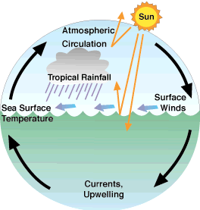
How do the ocean and atmosphere interact?
https://earthobservatory.nasa.gov/features/OceanClimate/ocean-atmos_phys.php

Slide 4
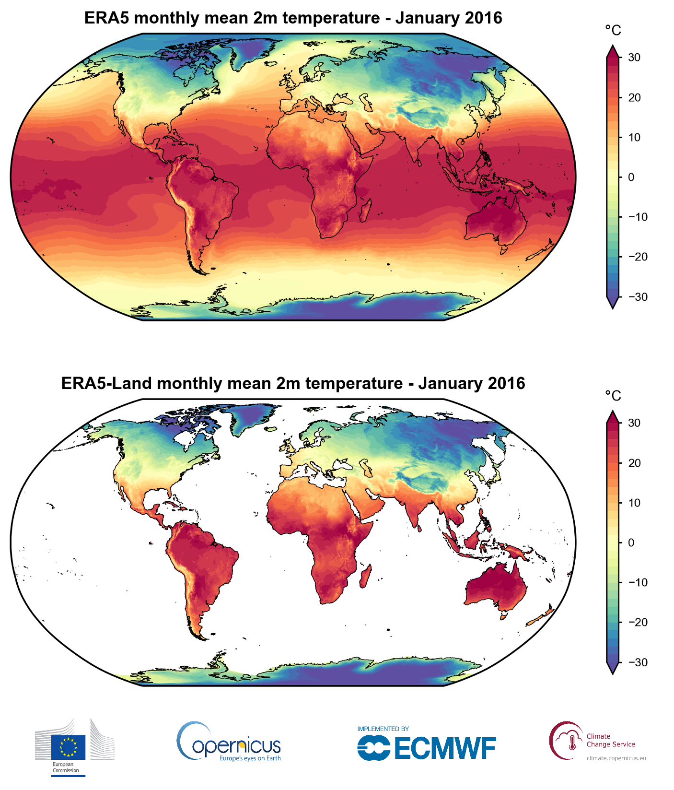
What is ERA5 data?
Reanalysis product from European ECMWF model
Assimilates observations into model to improve accuracy of simulation and fill in gaps in observations.
30 km grid
Data used from 1979-2019 for surface level
Sea Surface Temperature (SST)
Wind Components (Zonal and Meridional)
Total Precipitation

Slide 5



Computation Methods
Xarray library in Python
Get Climatology for 1979-2019 by grouping data monthly, seasonally, or annually and taking the time means.
Then subtract the climatology from 2016-2019 data to get anomalies
Notes:
This presentation relies heavily on anomalies, or differences from the long term trends. This is roughly how that’s calculated.

Slide 6
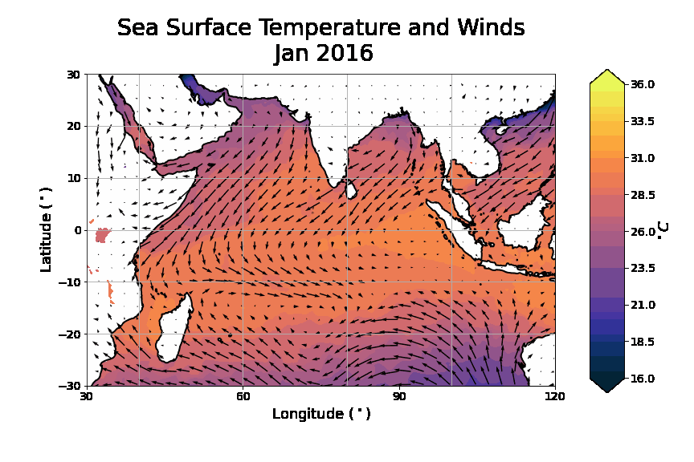
What is monsoon?
Seasonal Wind Reversal
India
Somalia
Upwelling by Somali Jet
Notes:
Interaction: Wind driven currents (winds change due to temperature contrasts setting up pressure gradients) change SST’s spatially ( IOD, up/downwelling), and SST’s affect evaporation, convection, etc.
Seasonal heating leads to wind reversals by temperature contrast between land and ocean, “Large scale seabreeze”. Onshore flows bring moisture and can clearly see orographic precipitation along Ghats, Himalayas.
Seasonal SST differences in Arabian Sea, Bay of Bengal, Etc have large impacts on monsoon rainfall. Upwelling by SW monsoon winds along Somalia bring biological productivity to Arabian Sea
Monsoon = seasonal, MJO = intraseasonal

Slide 7
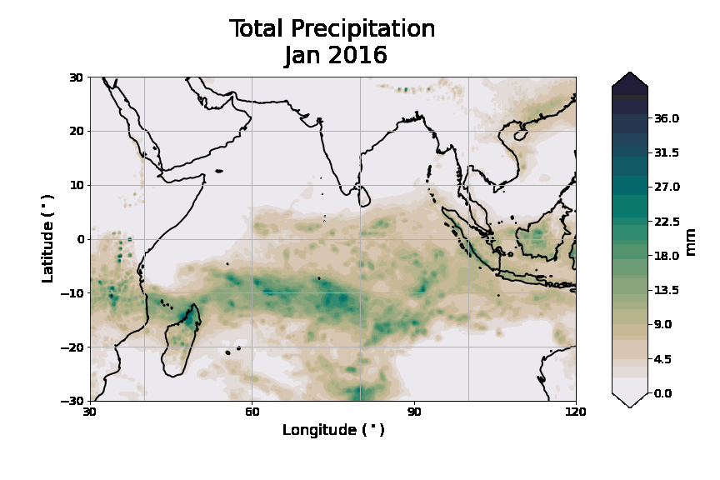
What is monsoon?
Monsoon Rainfall
Himalayas
Ghats
ITCZ formed by converging monsoon flow and SH trade winds in NH Winter

Slide 8
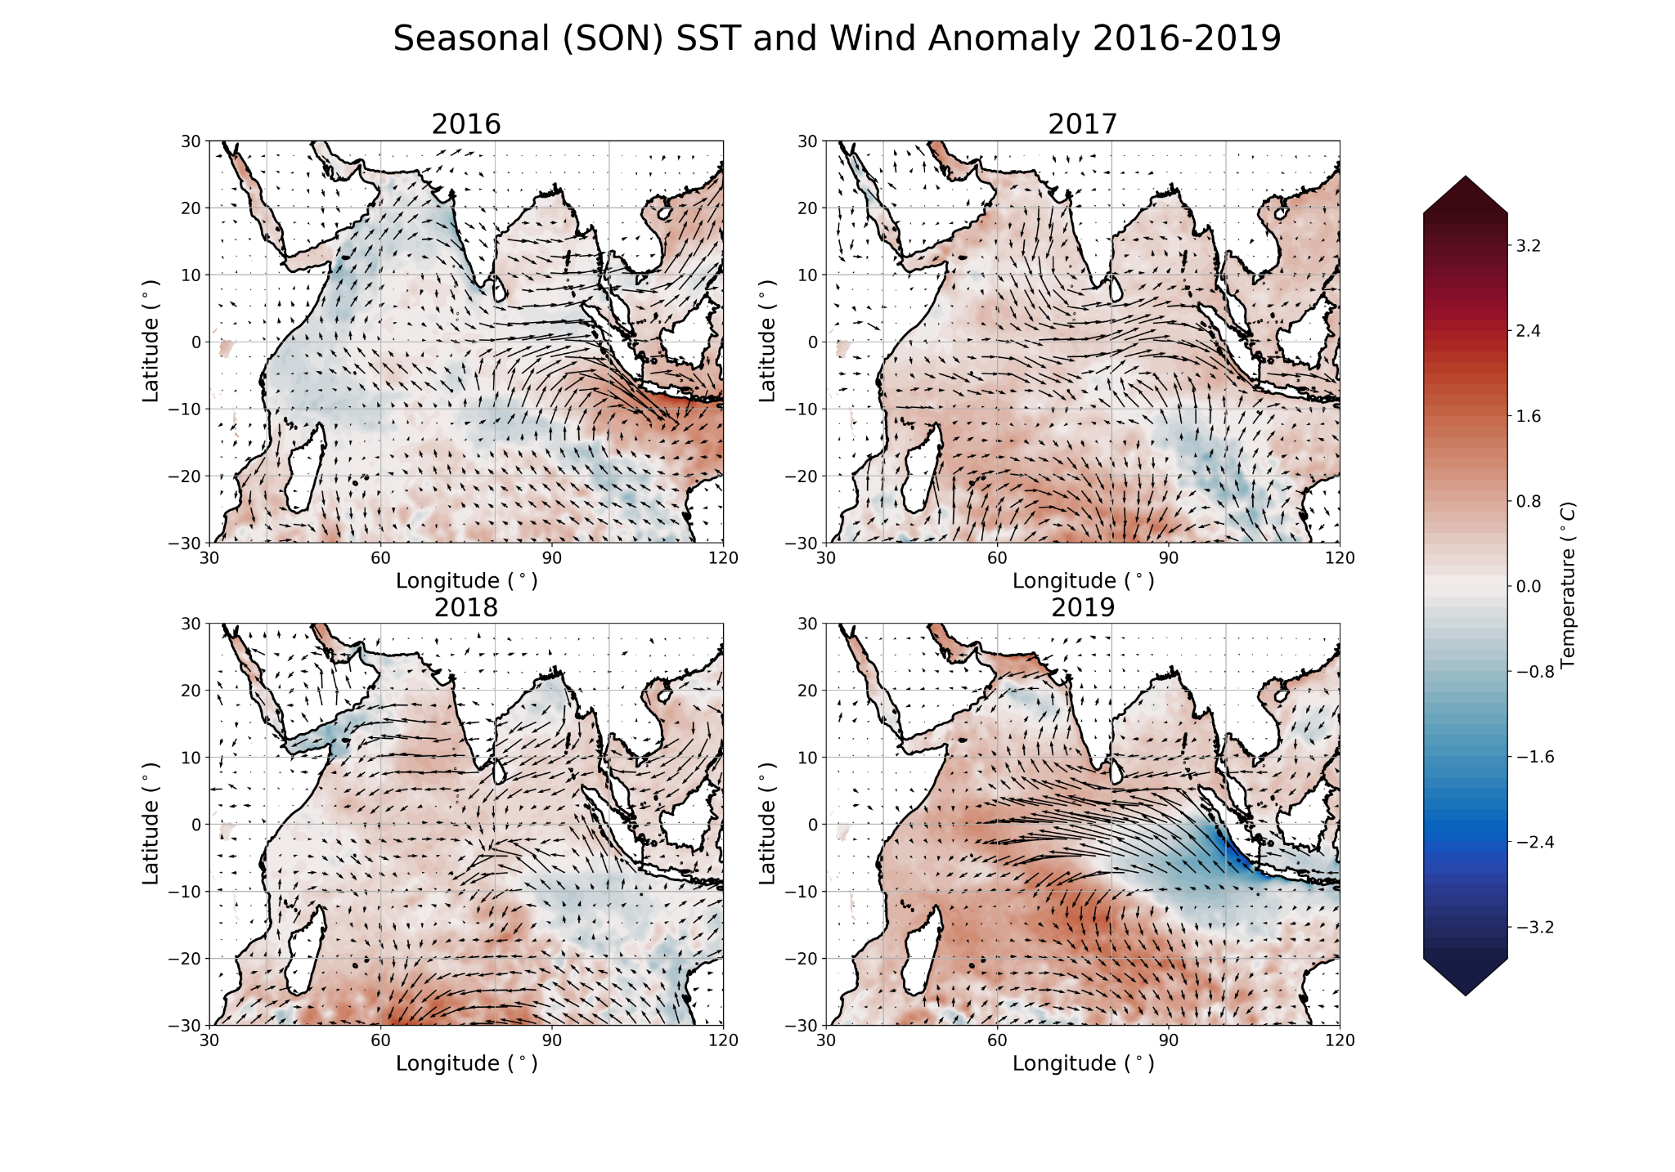
Indian Ocean Dipole (IOD)
Negative IOD
Positive IOD
Notes:
Cold anomalies associated with upwelling ( wind being driven away, cold water rising) downwelling=warming
Some of the wind variability is associated with convective changes due to ENSO effect on Walker circulation
IOD is ocean-atmos coupled form of variability, with feedbacks between zonal wind stresses and SST’s. Mostly during Boreal fall (Shorter than ENSO). Only time of year where upwelling isn’t drowned out by monsoon flow
SEP-NOV most evident. 2016 negative event, 2019 strong positive. Boundaries of IO cause winds to travel along gradient and drive strong upwelling/downwelling, enhancing the development of the IOD. We see these pattens along coasts of Somalia associated with the seasonal somali jet and along Sumatra/Java, where SE winds drive significant upwelling (Cold anomaly). Seasona heat balance of the basin strongly related to coastal waveguide processes driven by the wind, ie upwelling/downwelling

Slide 9
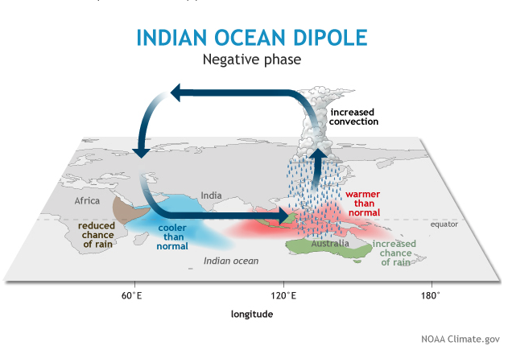
Negative IOD
Notes:
SST differences also create a circulation cell that crosses the Indian ocean

Slide 10
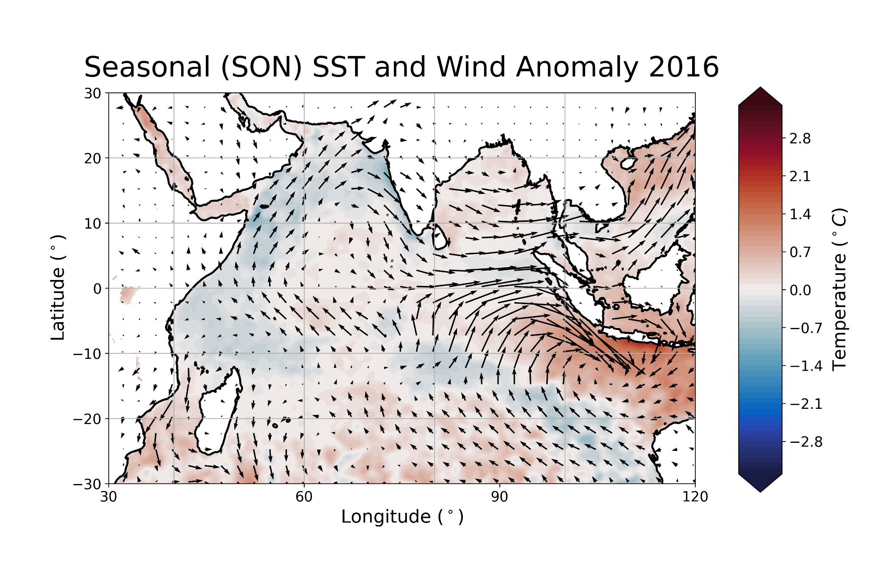
Negative IOD
Westerly Surface Winds
Western Cold Pool,
Upwelling from Somali Jet
Eastern Warm Pool,
Coastal downwelling
Notes:
LAnd boundaries force winds along coasts, leading to upwelling or downwelling

Slide 11
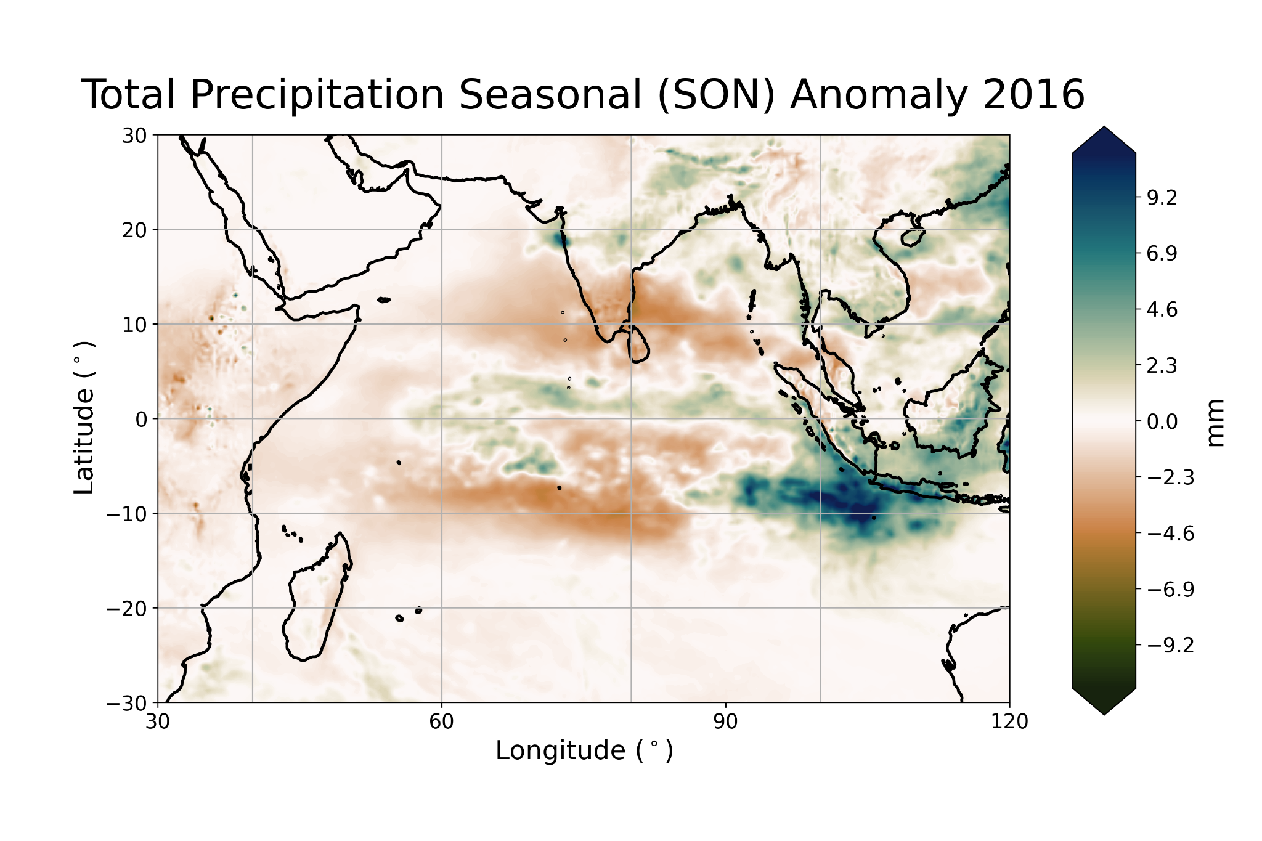
Negative IOD
Enhanced Rainfall over SE Asia, Maritime Continent
Drier in East Africa

Slide 12
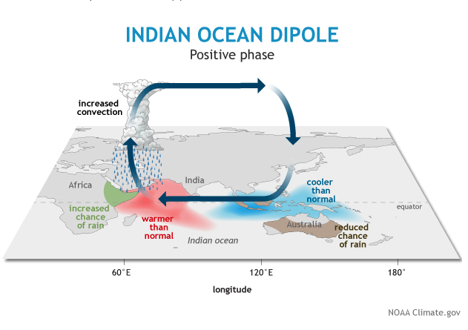
Positive IOD
Notes:
Positive IOD tends to suppress MJO, Since MJO effects evolution of ENSO, there is singinifcant effect of IOD phase on ENSO evolution. MJO also has effect on Atlantic hurricance evolution and winter storms in US, so again, IOD phase plays role in global weather.

Slide 13
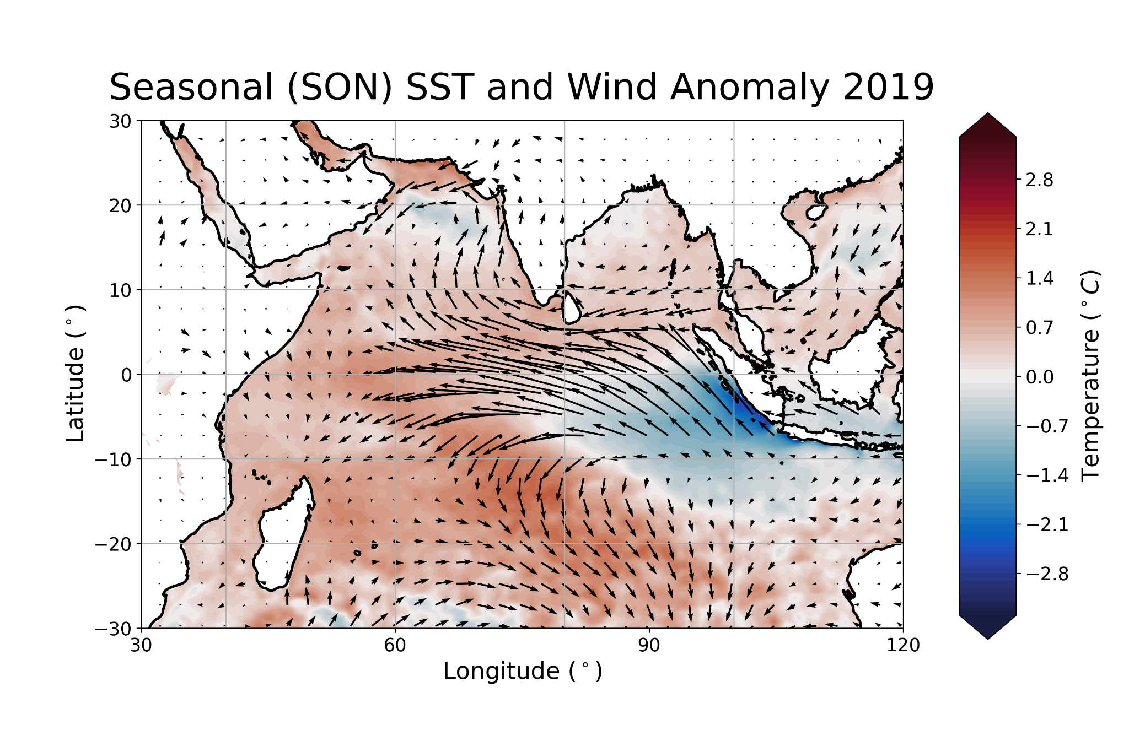
Positive IOD
Surface Easterlies
Western Warm Pool, Coastal Downwelling
Eastern Cold Pool, Coastal upwelling

Slide 14
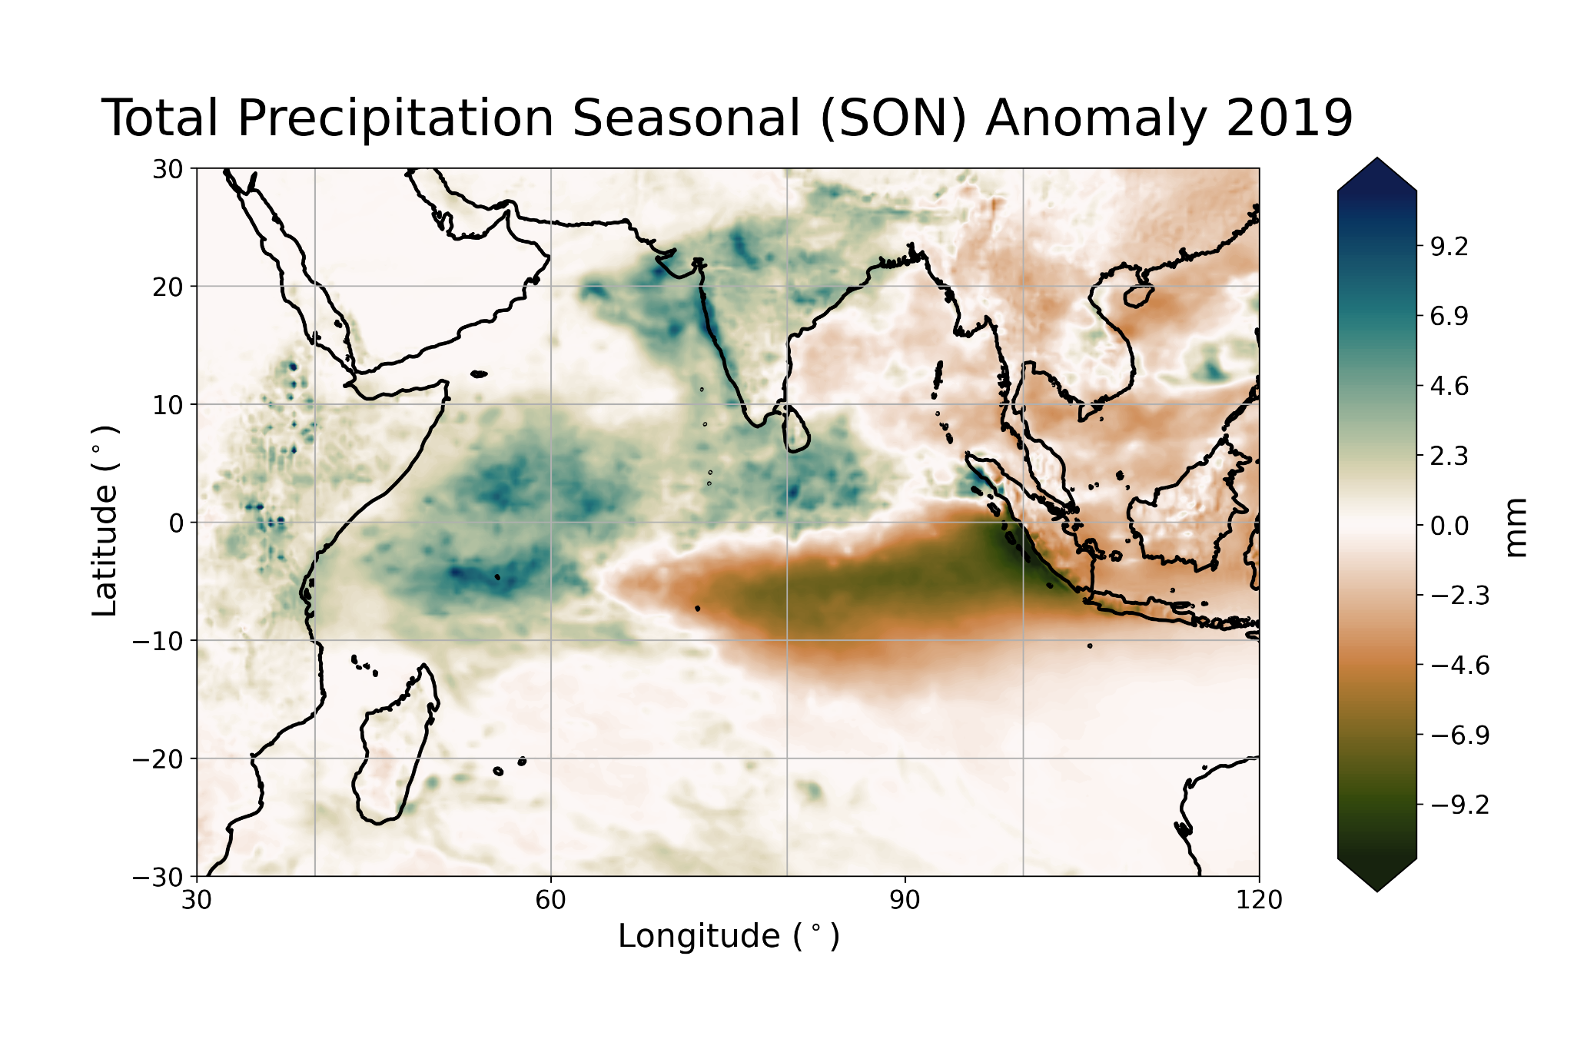
Positive IOD
Drier in SE Asia, Maritime Continent
Wetter in East Africa

Slide 15
Opposite IOD phases
Strong Negative IOD (2016)
Strong Positive IOD (2019)

Slide 16
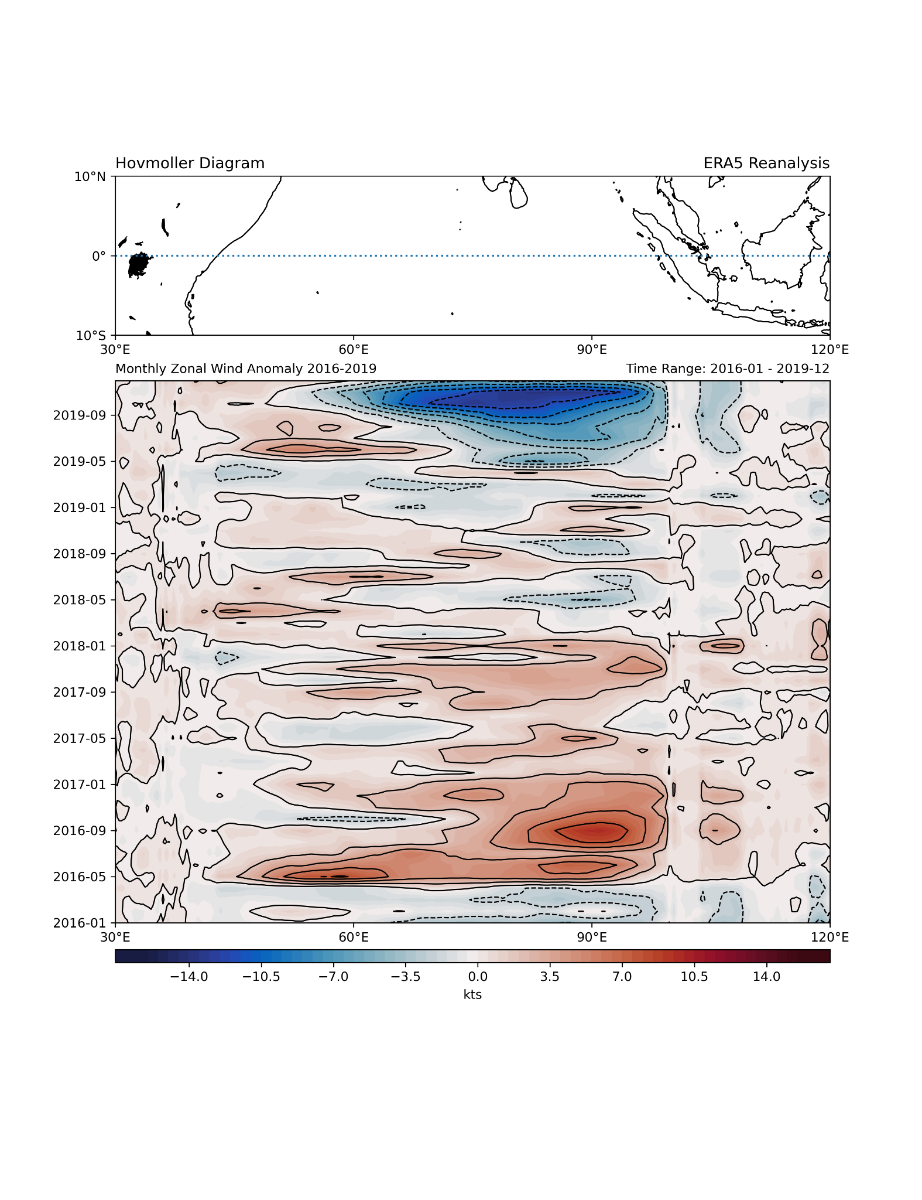
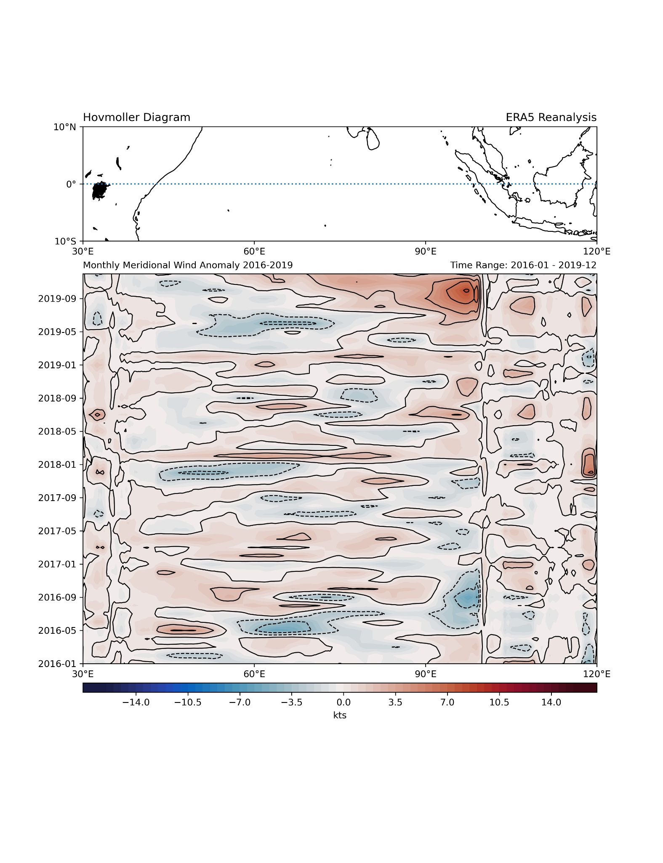
Temporal Evolution of Zonal and Meridional Wind components along the Equator
Notes:
Easterlies + Southerlies near Sumatra and Java drive coastal upwelling, bringing up cool water and enhancing the IOD. Zonal winds at equator can drive equatorial jets, which are of interest.

Slide 17
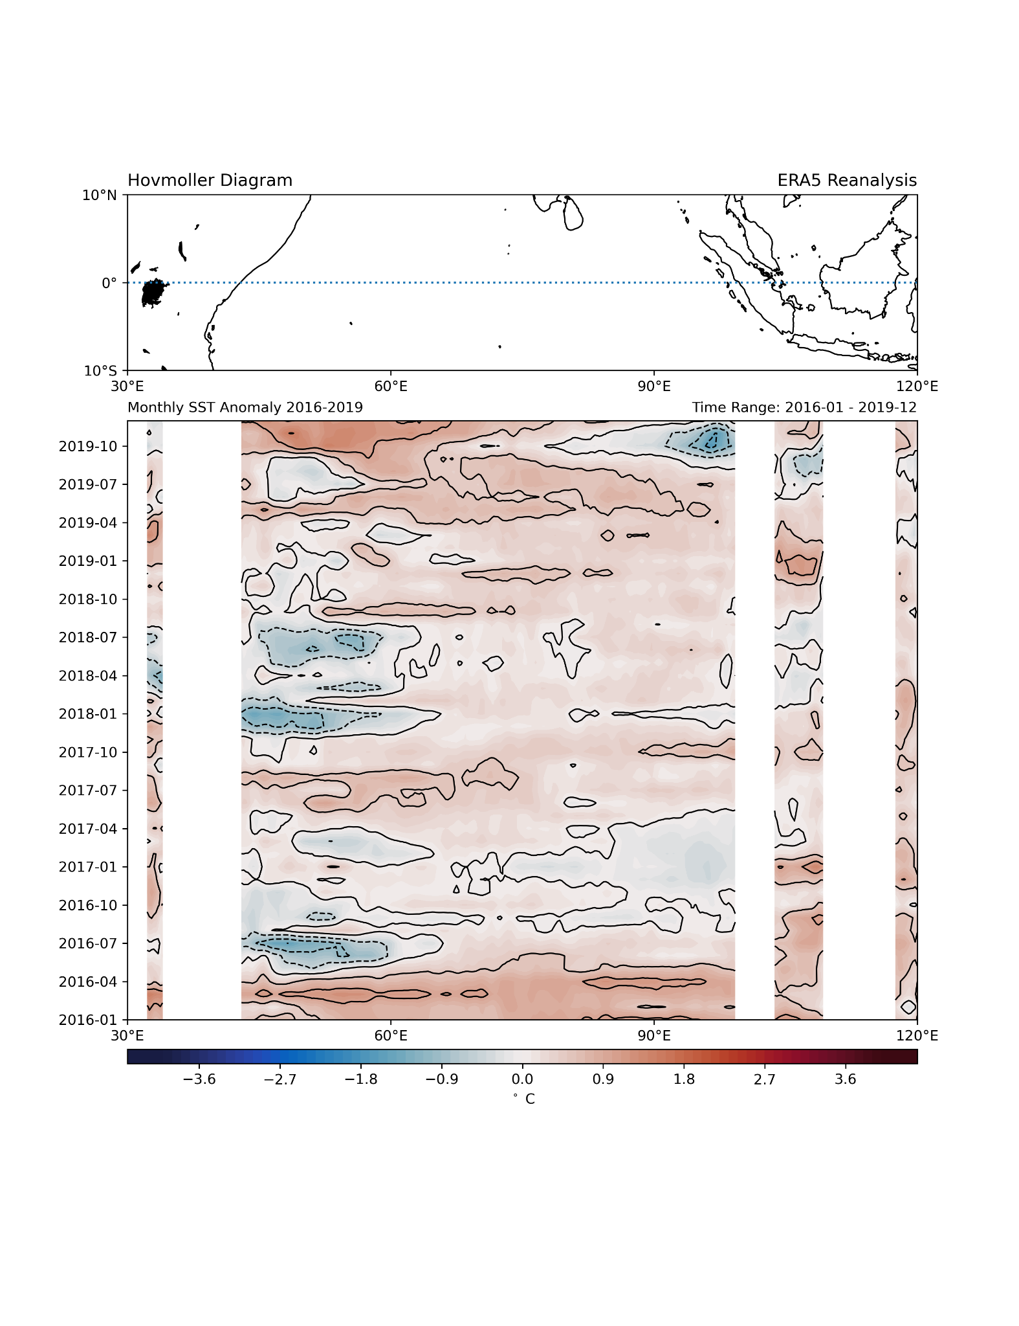
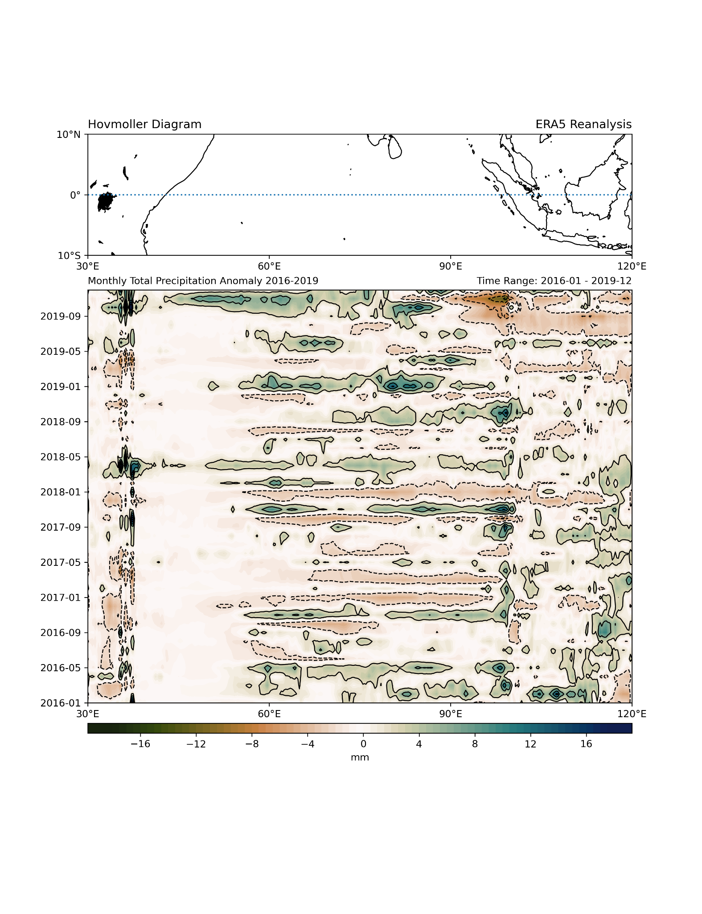
Temporal evolution of SST and Precipation evolution
Notes:
Clearly can see SST anomalies correlated with rainfall in many locations. General trend is that cooler water = less evaporation/convection = less rainfall, and vice versa.

Slide 18
Summary and Conclusion
Seasonal monsoon and IOD have significant role in influencing global weather and climate.
Large number of variabilities over small spatial scale require increased availability of observations to better characterize.
Current efforts include satellites and the Research Moored Array for African–Asian–Australian Monsoon Analysis and Prediction (RAMA)
Notes:
IOD initmately conencted to MJO and ENSO, raises questions such as does ENSO influence IOD, IOD on ENSO, or both ways?

Slide 19
Acknowledgements
Dr. Mike McPhaden: For mentoring me!
NOAA William M. Lapenta Internship: For providing this opportunity and funding
PMEL: For all the great folks who have provided guidance and encouragement.

